Slide 1
Ceres AWX Project
Automating the deployment of an Automation Platform

Slide 2
Who am I and what is this project?
My name is Richard Gowen and among other things, I architect and implement security automation solutions for cloud infrastructure.
Twitter: @alt_bier Mastodon: @alt_bier@defcon.social
Projects: altbier.us Resume: gowen.net/resume/
GitHub: github.com/gowenrw
The Ceres AWX Project is my attempt to bring the power of the enterprise (and thus expensive) Ansible Automation Platform (AAP) to the individual user easily via AAP’s upstream project AWX.
While AWX is free to use, it can be difficult install and configure.

Slide 3
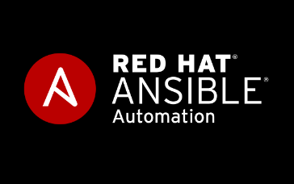

What is Ansible?
Fictional Instantaneous Hyperspace Communication System featured in Orson Scott Card’s Ender’s Game
Simple To Use IT Automation Software For Orchestrating Advanced IT Tasks
THIS ONE
Not this one →

Slide 4
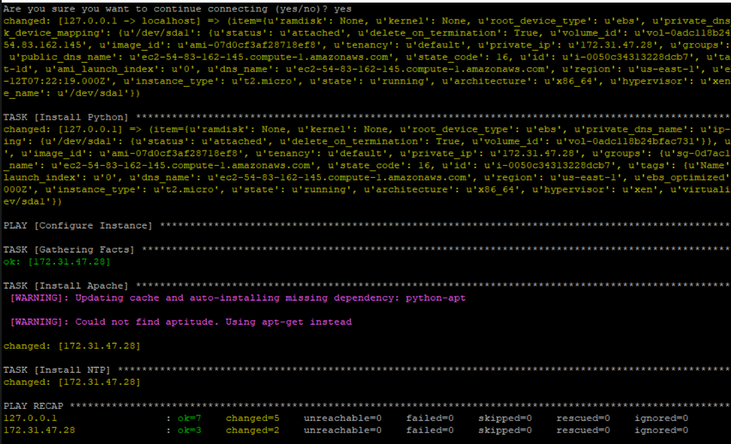
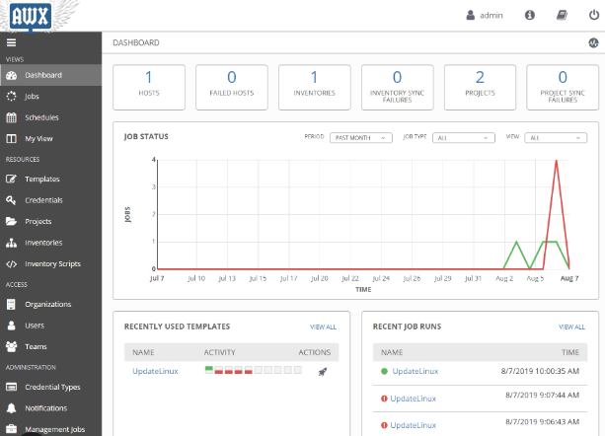
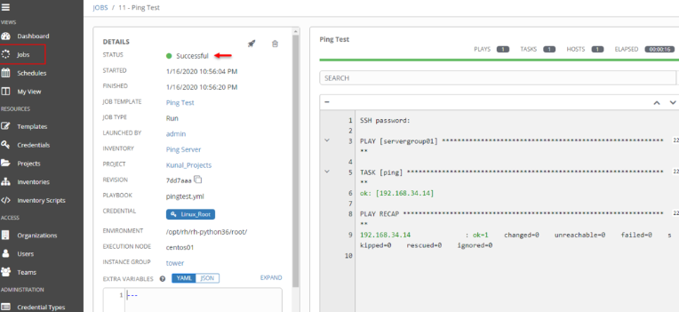
What are Ansible Automation Platform & AWX?
While Ansible in it’s CLI form has been around for more than a decade, scaling it up for enterprise use has always been a challenge.
Ansible Automation Platform (AAP) and its upstream project AWX tackle this challenge by bundling Ansible and several other tools together in a scalable enterprise grade platform with an easy-to-use web interface.
CLI vs. Web UI →

Slide 5
Why use AWX versus the CLI?
The power of Ansible is that there are many community collections of code already written to do the things you need to do. But they all have different python module requirements which may cause conflicts. This can lead to complex python virtual environment configurations on the Ansible host.
Newer versions of Ansible tackle this with ‘Execution Environment’ containers. While its possible to use EE’s in the CLI this adds complexity and is not scalable
AWX and AAP make use of EE containers in a portable, scalable, user-friendly interface. In addition, these platforms have other features not available in the CLI, such as job scheduling, workflows (tying jobs together), target inventory mgt, credential mgt, external authentication hooks (e.g., key vaults), and more.

Slide 6
What does the Ceres AWX project do?
The main goal of this project is to automate the provisioning of Ansible AWX on a local VM or a VM in the cloud.
Another goal is to automate the creation of custom Ansible execution environments for use with ansible-navigator and AWX.
Finally, I wanted to meet these goals in a way that is accessible to those with limited Ansible knowledge (i.e., lots of documentation).

Slide 7
How to use the Ceres AWX project
Ready the local environment by installing requirements
ansible-navigator and podman or docker (see project README for details)
Get a Target VM ready for AWX
Minimum Hardware: 2 CPU cores & 8GB RAM & 10GB Free Disk
This can be a local VM or a VM in a cloud environment
Current OS requirements:
Local: CentOS Stream 9 or Rocky Linux 9 - Cloud: RHEL 9
For convenience, this project contains a Vagrant/VirtualBox configuration as well as an Azure setup automation job to provision the target VM
For a local VM simply invoke vagrant with vagrant up ceres-c9
The Azure setup job creates the VNET, Subnet, NSG, ASG, NICs, and VM
You need to supply as variables the Azure Tenant-ID, Subscription, Resource-Group, and Service-Principal details then run this playbook:
ansible-navigator run ceres.playbook.azsetup.yml

Slide 8
How to use the Ceres AWX project
Execute the Ansible automation playbook to provision AWX (including all it’s requirements such as Kubernetes) onto the target VM
For a Local VM (CentOS Stream 9 / Rocky Linux 9) use this playbook:
ansible-navigator run ceres.playbook.dev.yml
For a Cloud VM (RHEL 9) use this playbook:
ansible-navigator run ceres.playbook.qa.yml

Slide 9
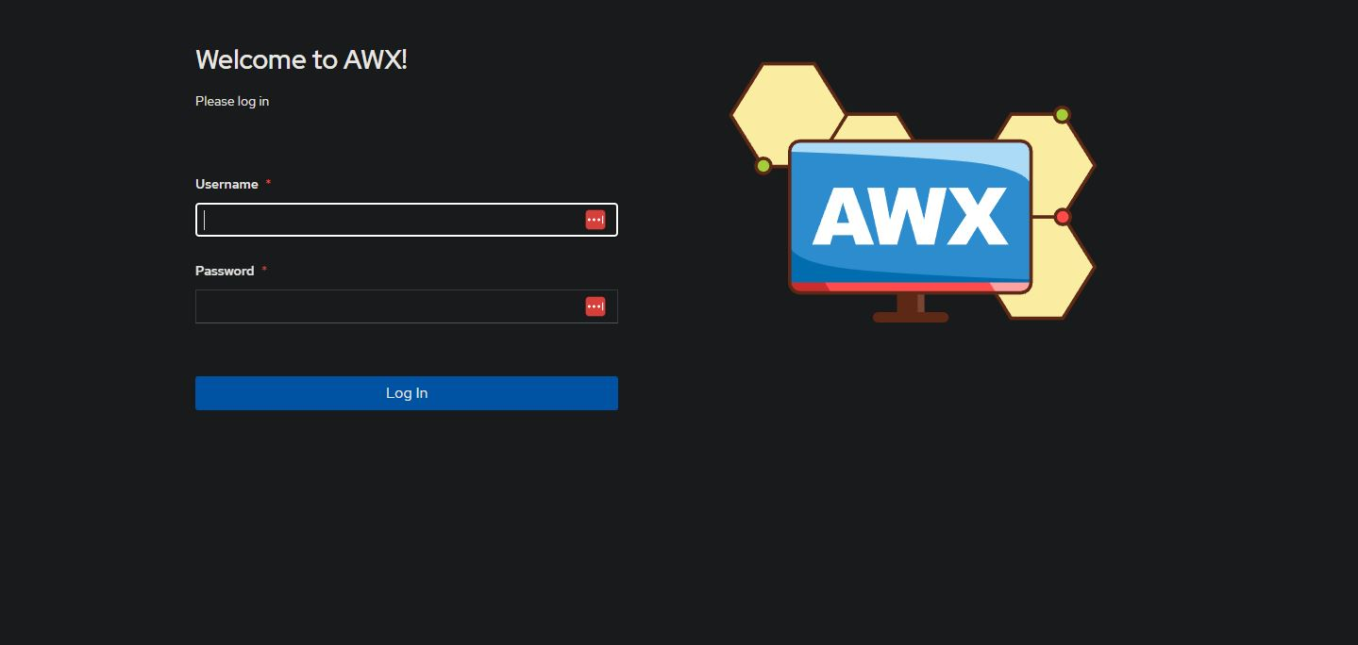
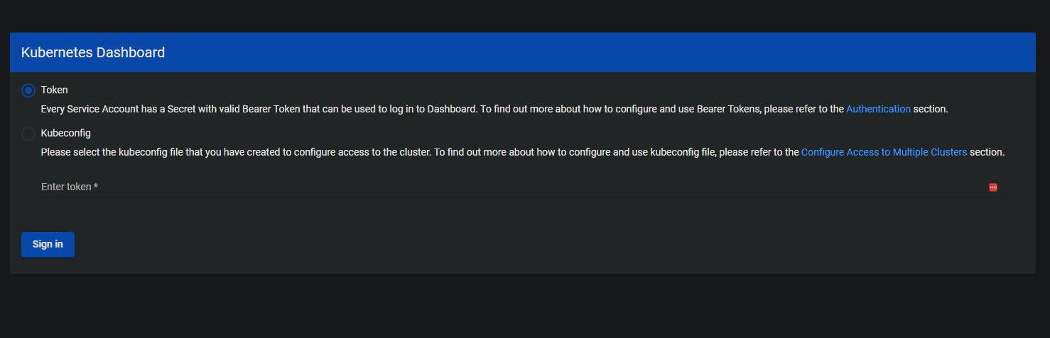
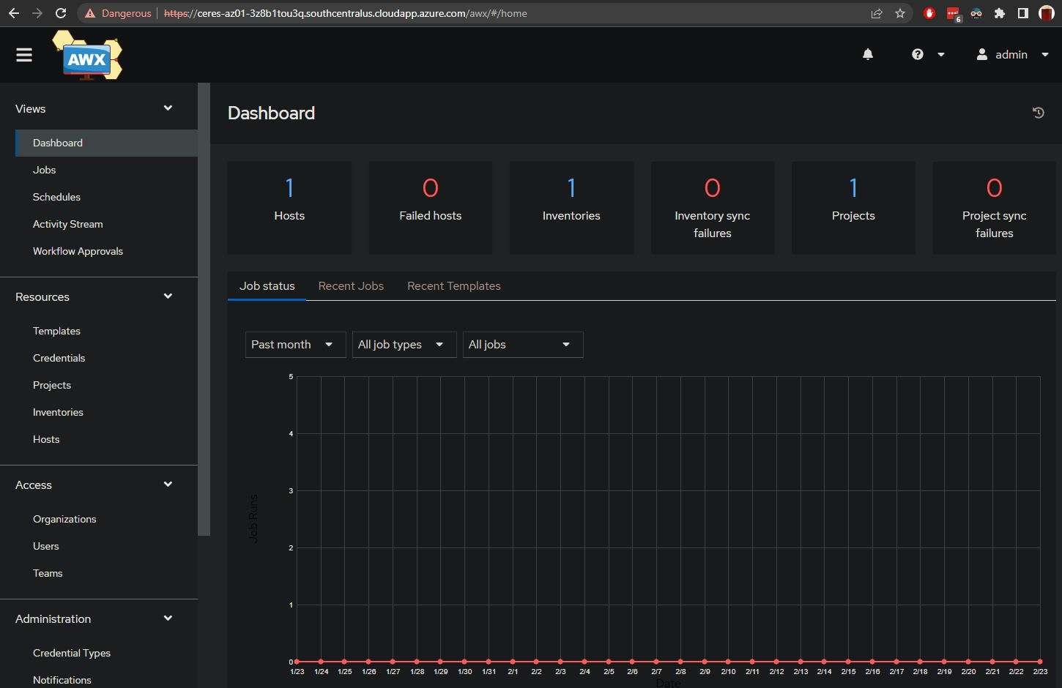
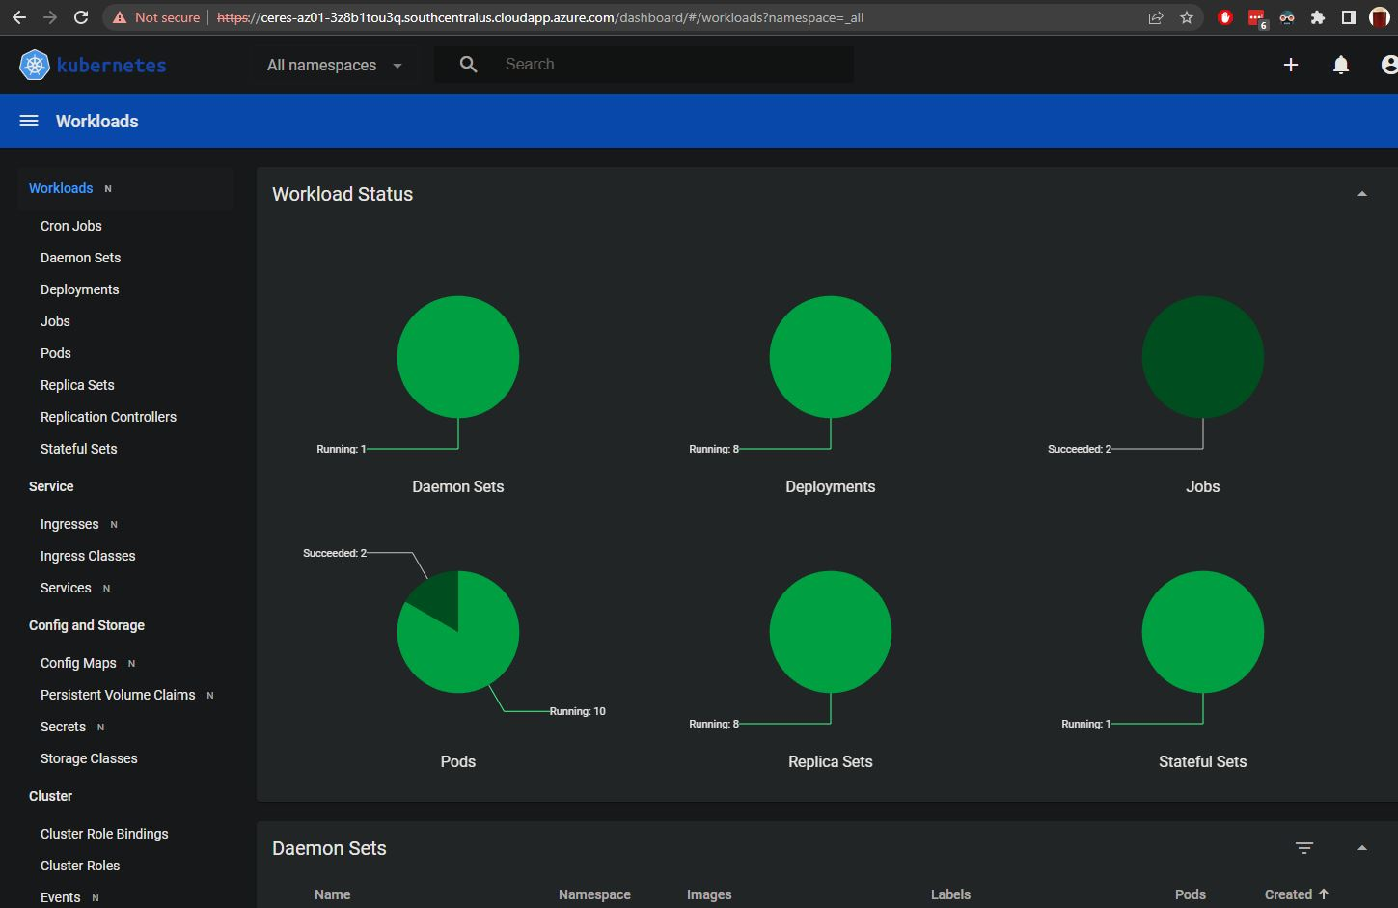
Enjoy AWX!
When the automation job completes it will present you with the login information (URL & Auth) for the Kubernetes Dashboard and AWX.

Slide 10
Where Can I Get The Ceres AWX Project?
Ceres AWX is a public project on GitHub available here:
https://github.com/gowenrw/ceres_awx
The project is an ongoing work as I look to expand its use to other operating systems and other cloud environments.
Feel free to let me know if you see something that can be improved.
Thanks.
Richard Gowen a.k.a. @alt_bier

